Slide 1


Year 1 Transition to Year 2
Welcome everyone!
2026-2027
Bowerham Primary and Nursery School and Baby Unit

Slide 2
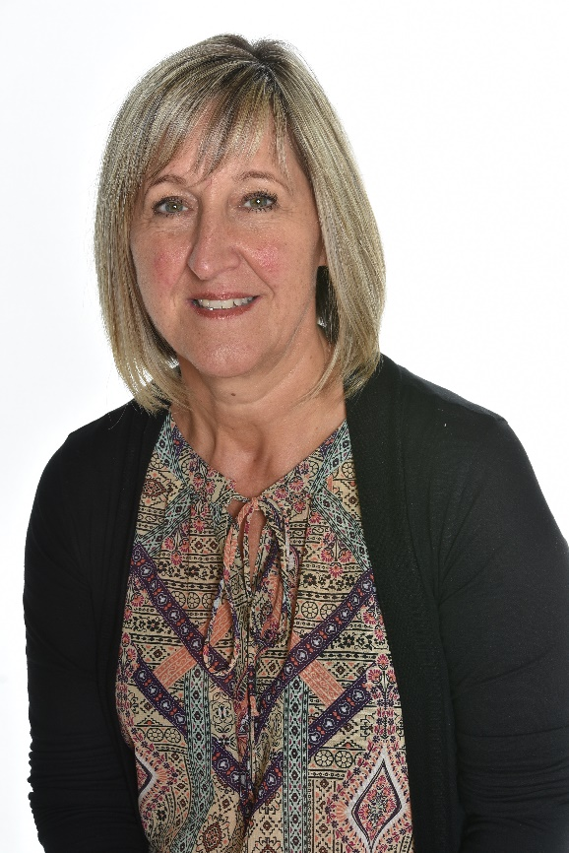



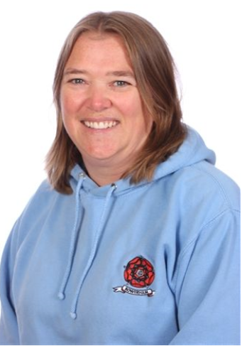
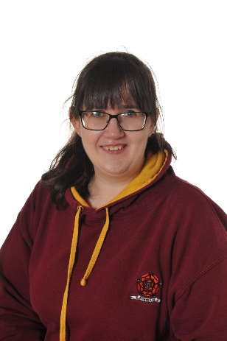
Year 2 Teachers
Mr Essa
Miss Bailey
Miss Henderson
Mrs Bradshaw
Mrs Carradice

Slide 3
Your classroom door will say 2LB or 2UE!

Slide 4
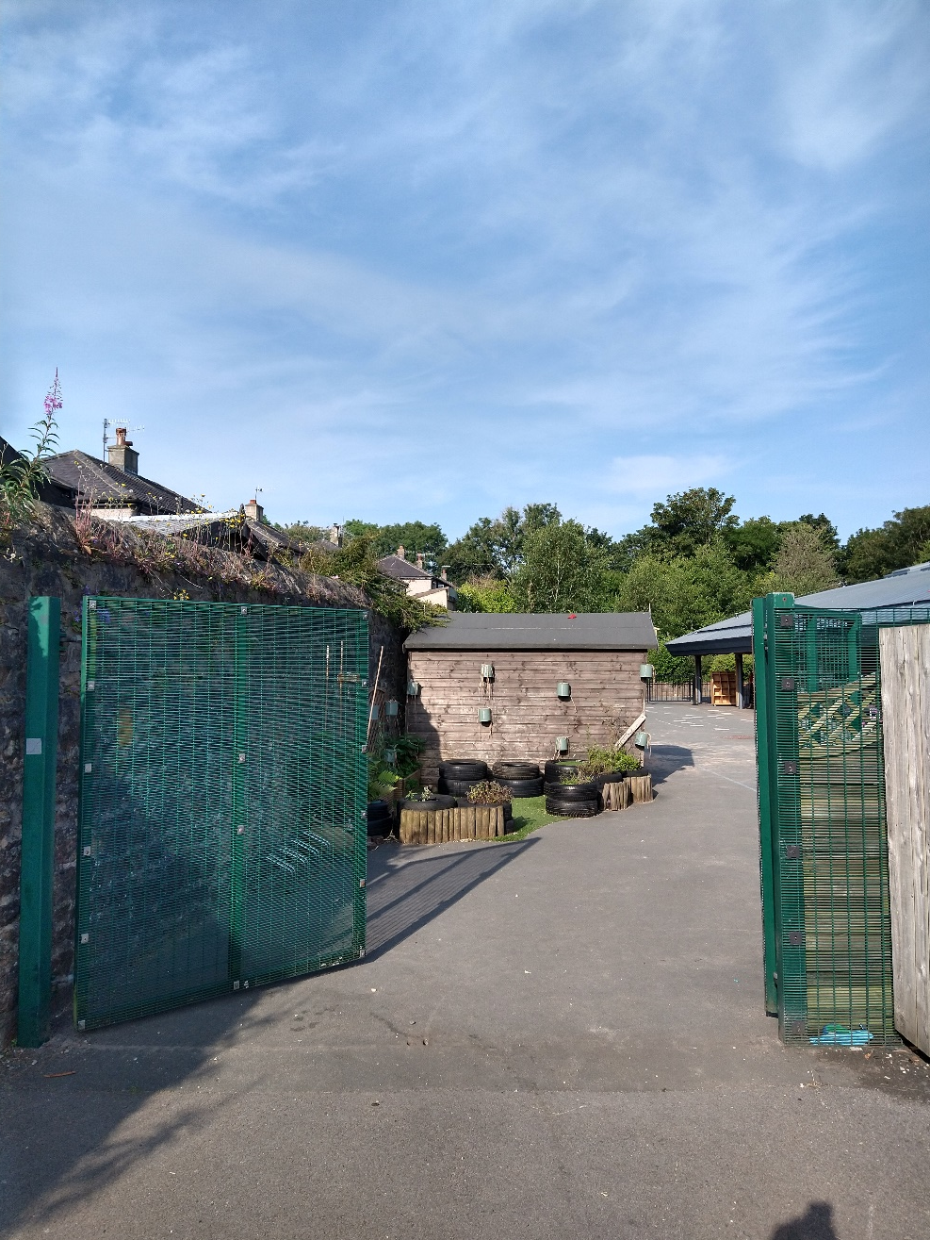
This is what you will see when you come through the green gates...

Slide 5
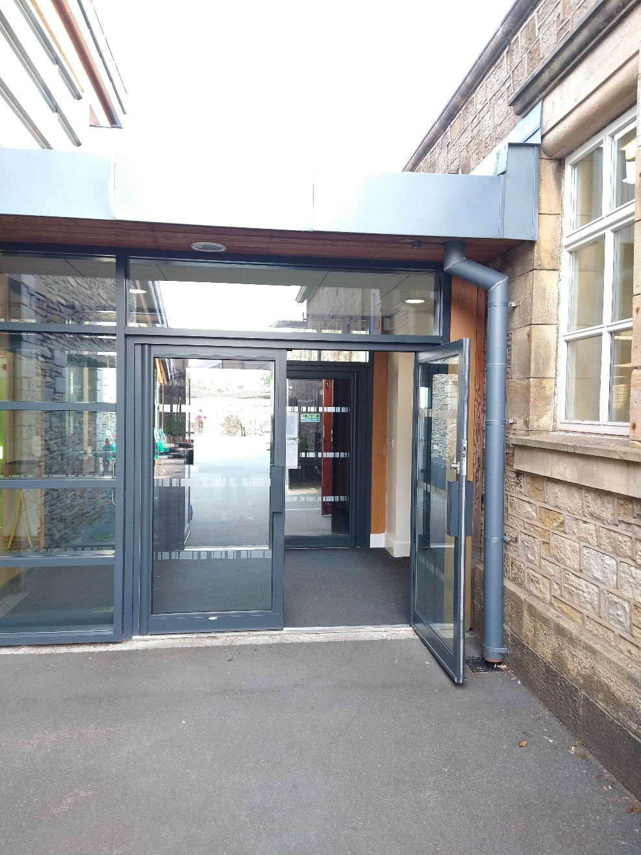
You will enter the Year 2 Classrooms through the side doors.

Slide 6
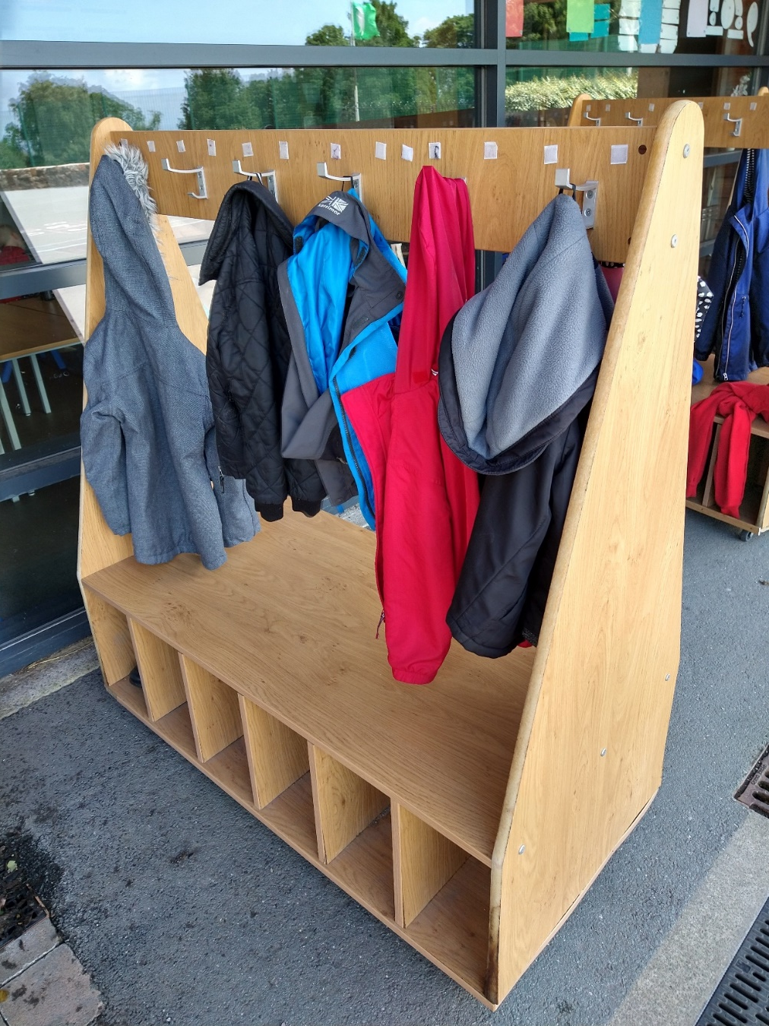
You will have your own peg outside the Year 2 classrooms where you can hang your coat.
Starting in September, all children will need to bring a bag that fits inside their tray — ideally a drawstring bag or a book bag.
We understand drawstring bags may not be as comfy as rucksacks, so if you prefer, a small/mini rucksack that fits in the tray space is fine.
The dimensions of the children’s trays are 37cm x 28cm.

Slide 7
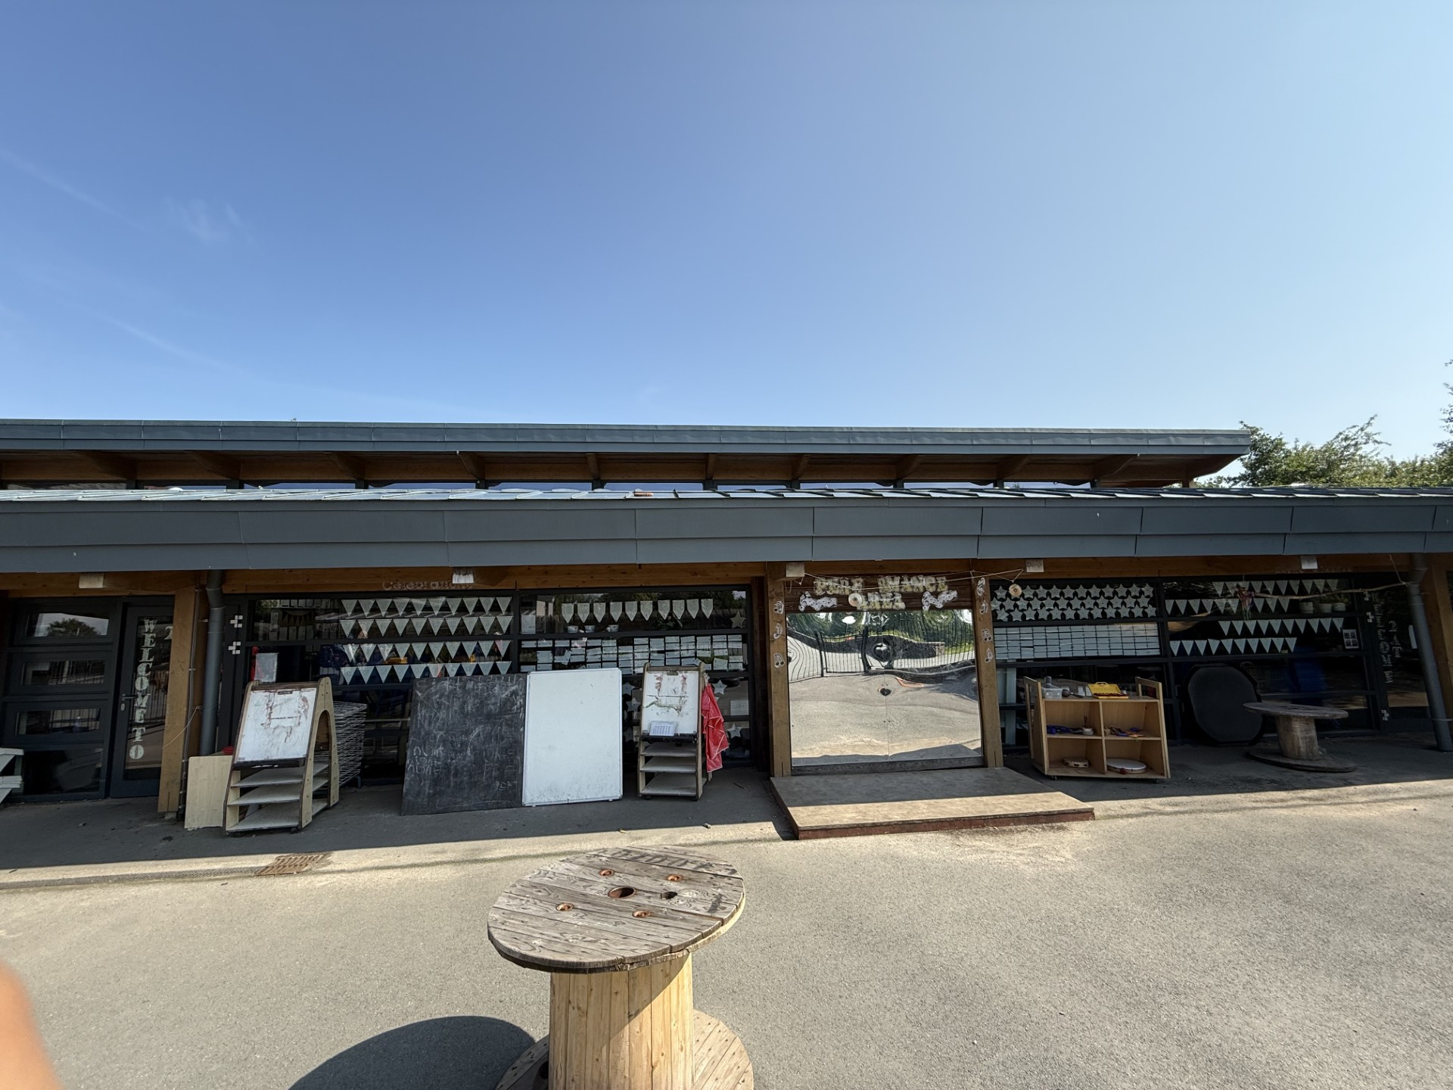
You’ll then come through the black gates into the year 2 playground and enter through your classroom door

Slide 8

Book Box
As you arrive in the classroom, you will bring your Reading diary and reading book with you each morning and place it into the book box.
Staff members will check your diary each day for any messages from you and change your reading book when needed.
We also share key messages or comments in the diary! ☺

Slide 9



Reading at home
Your child will bring home reading books to enjoy and return to school regularly.
Reading at home is a vital part of their progress in Year 2.
We also use Bug Club, an online reading platform. Please encourage your child to use Bug Club alongside their physical books to support their learning.

Slide 10
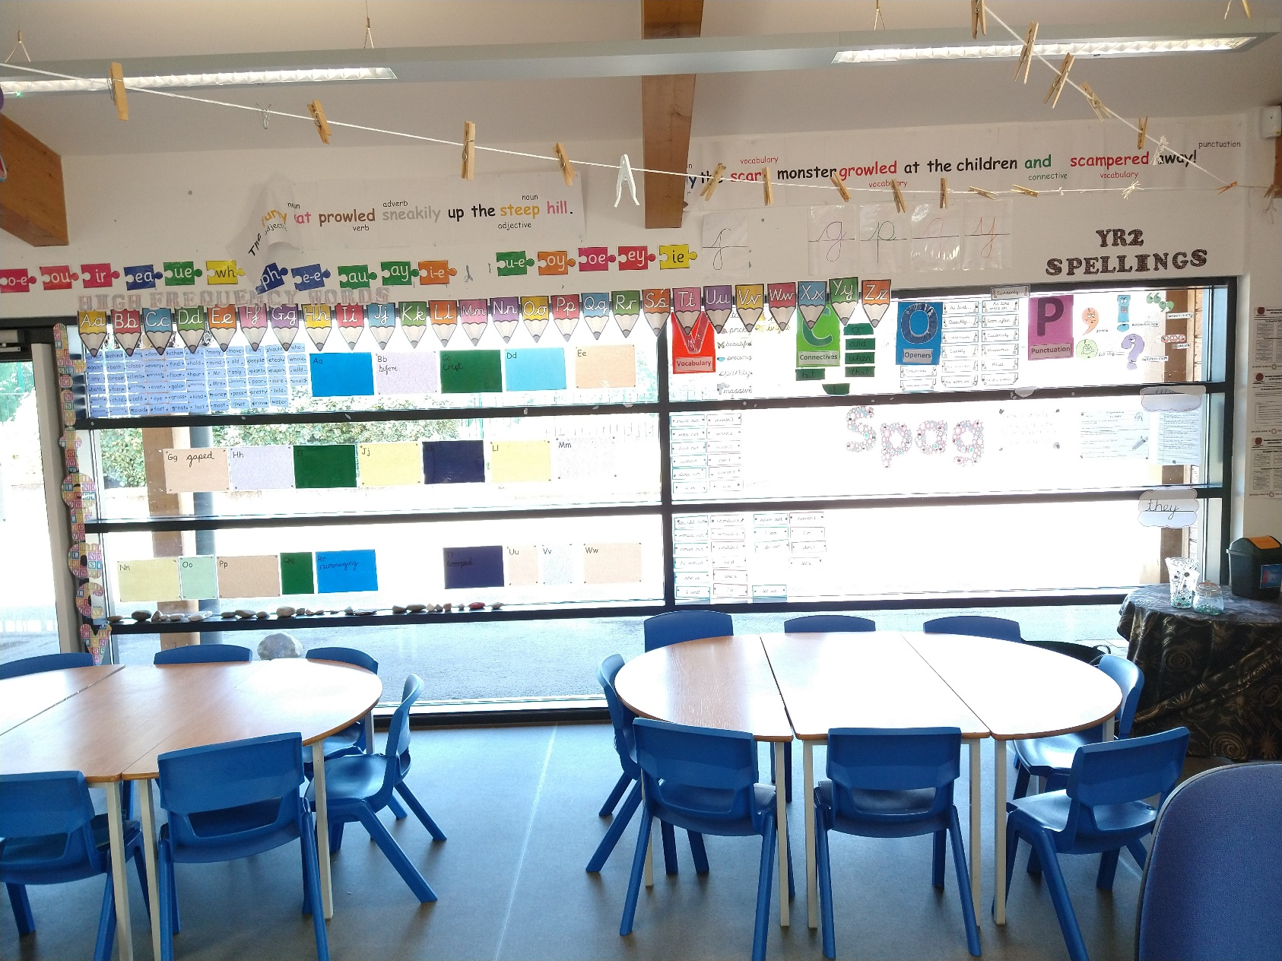
Year 2 Classrooms...

Slide 11
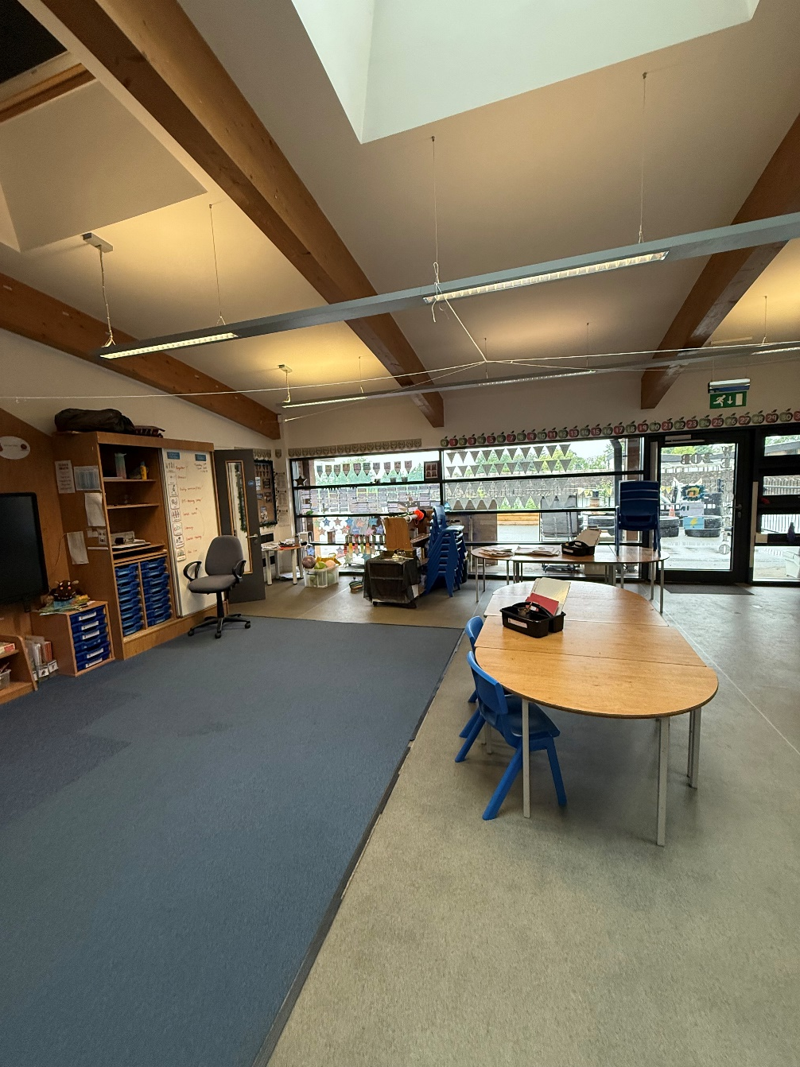
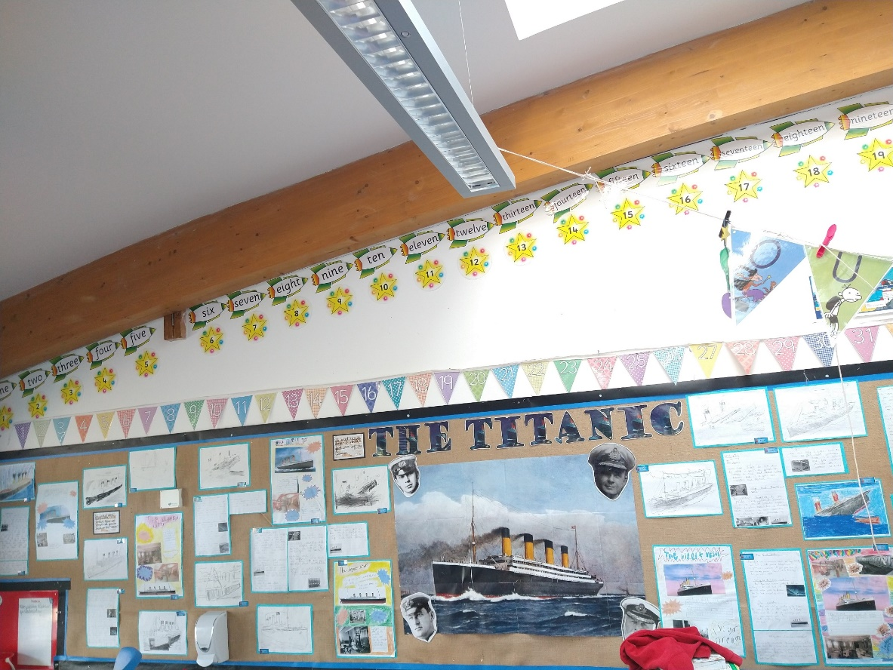
Year 2 Classrooms...

Slide 12
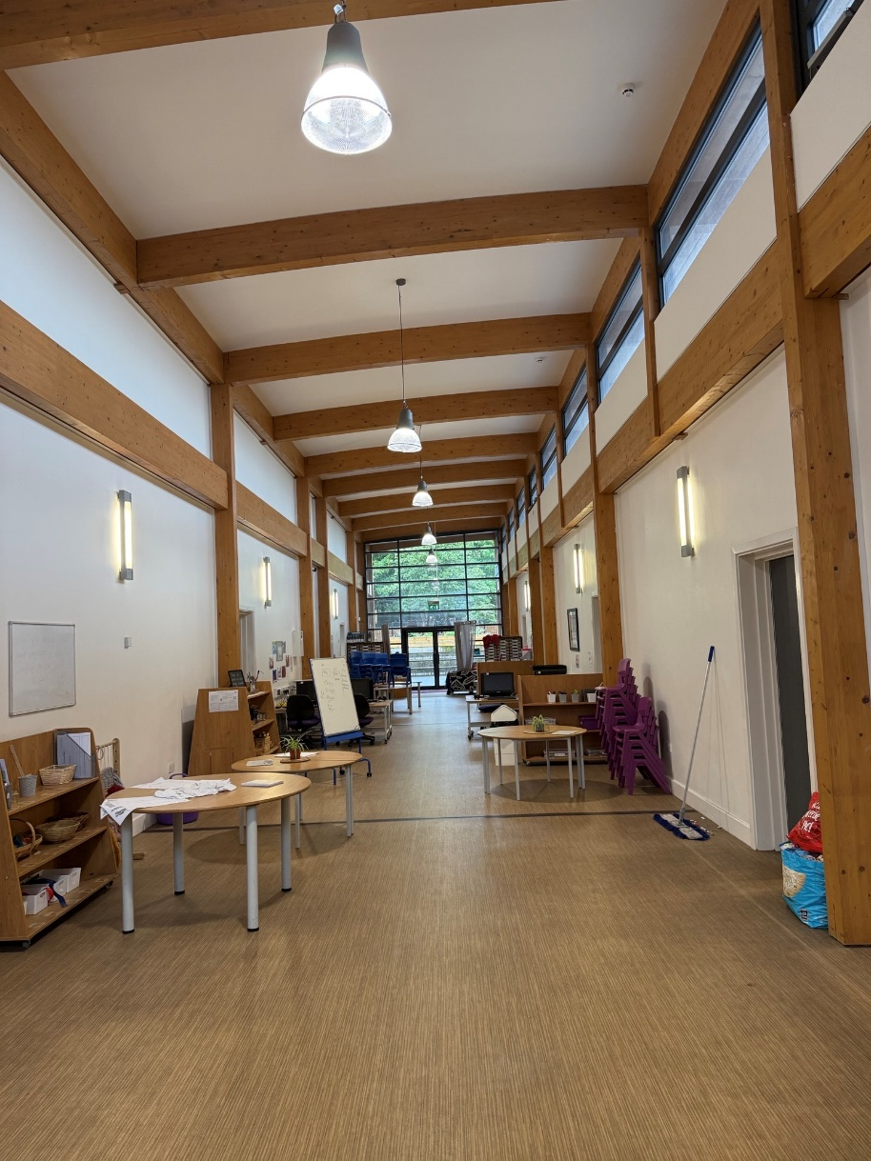
The KS1 corridor

Slide 13
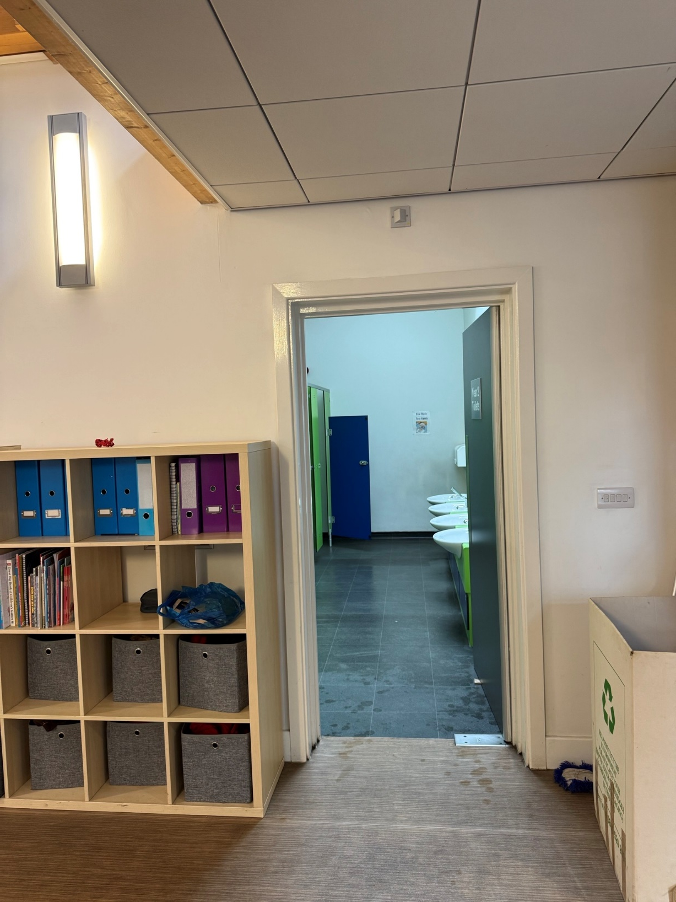
Year 2 toilets

Slide 14
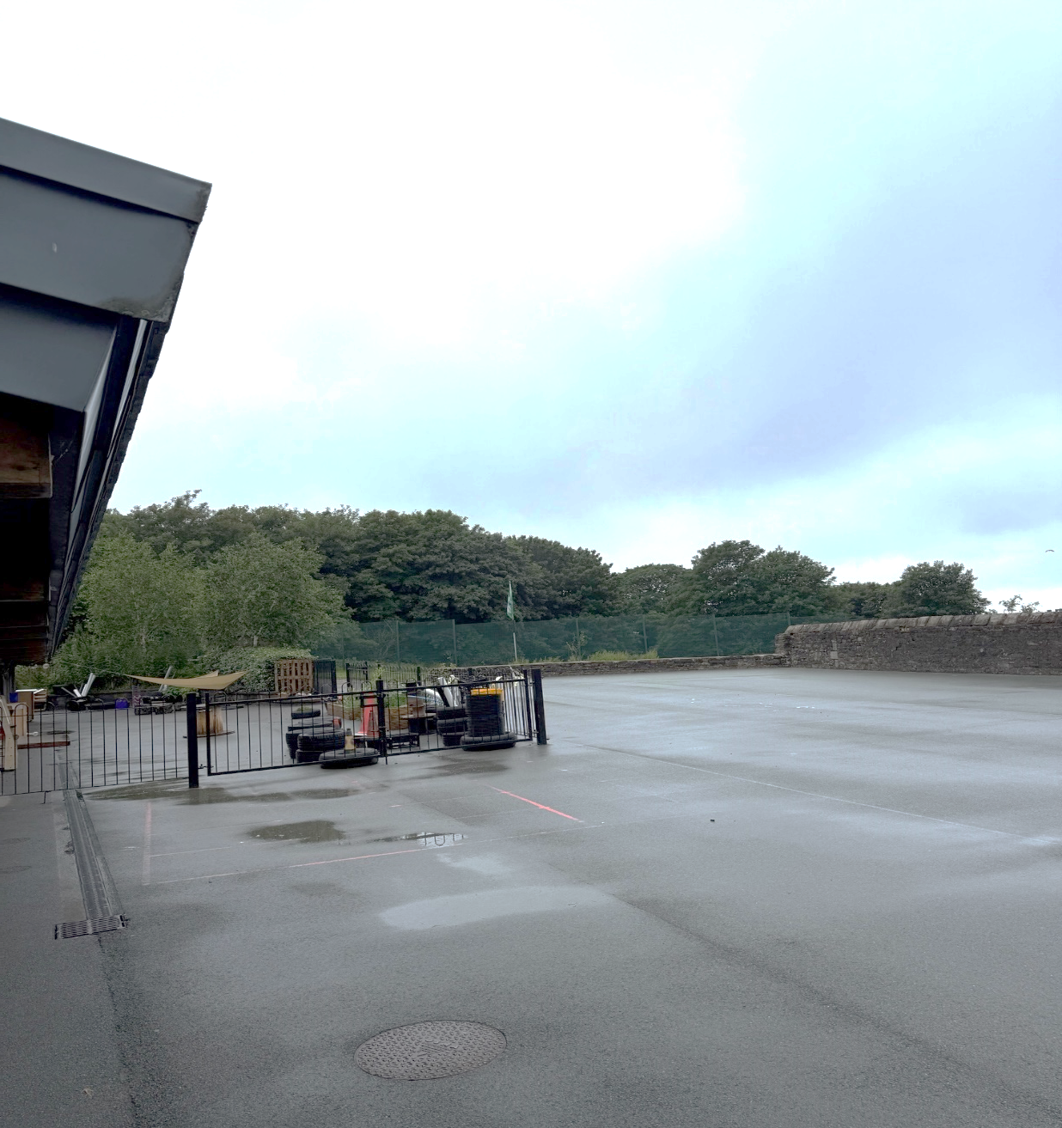
Outdoor Area

Slide 15
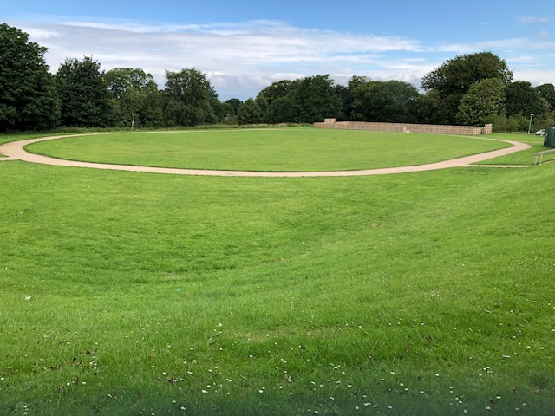
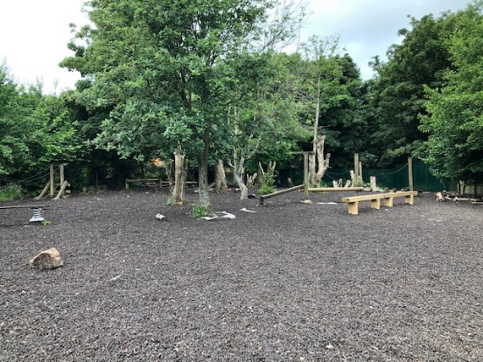
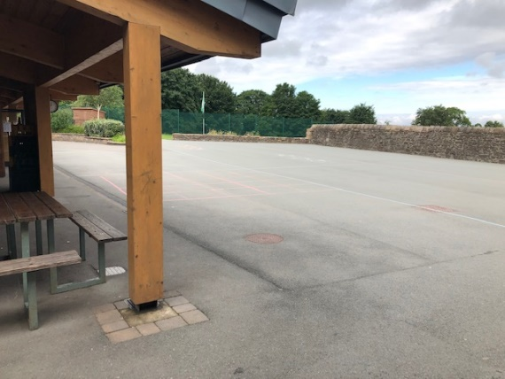
Playtime and Lunchtime
Field
Trim trail
Playground

Slide 16
Year 2 P.E day:
Friday

Slide 17
Year 2 Fund
We will have a fund in Year 2 similarly to Year 1, which we will use to purchase little extras that will enhance our classroom, curriculum enrichment opportunities and snack area.

Slide 18



Behaviour
The Bowerham Bear System
In Year 2, we use the Bowerham bear System to support positive behaviour.
Each day, children begin on the happy Bowerham bear, which represents a positive and fresh start.
If a child does not follow our Bowerham Best rules, they may move their name to the straight face or sad face as a visual reminder.
Our Bowerham Best rules are:
We listen
We are honest
We are gentle
We are kind
We work hard
We look after our property
In Year 2, we celebrate positive behaviour in lots of exciting ways!
Children can earn stickers, happy boxes, and team points for showing their Bowerham Best.
As a class, we also work together to collect 50 marbles in the jar. Once we reach our goal, we enjoy a special whole-class treat called Marble Day!

Slide 19


Snack time
Your child will have access to fruit and other snack items daily.
If you would like your child to have milk this is a payable service. Please see the office for more details.

Slide 20

Areas of Provision
In the classrooms, corridor and outdoor area we have lots of exciting areas which give you opportunities to learn through play and challenges!

Slide 21


In Year 2 we will continue to use Showbie as our online learning platform everyday. We will engage and communicate with you through Showbie, keeping you up to date with what we are doing and sharing any key messages.
It is really important that you engage with Showbie as your child’s classwork, homework and other information such as awards, reports and curriculum support resources can be found here as in Year 1.

Slide 22

We cannot wait for you to join us in your new classroom!​
​
The Year 2 Team

